Slide 1



Spring 2021
TEP4290 Modeling of Built Environment Systems
Remarks on warm-up 3 and multiplication tutorial
Fernando Aguilar Lopez

Slide 2
In a nutshell
DSM and building model under control
Plots, exporting and reading results seemed fine as well
Multiplication with Python arrays was main issue (time/cohort)
We will do a tutorial on this
Consider lifetime when deciding the timeframe of your model

Slide 3
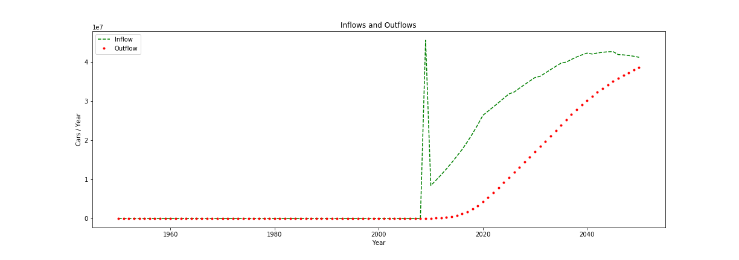
What could be the issue here?

Slide 4
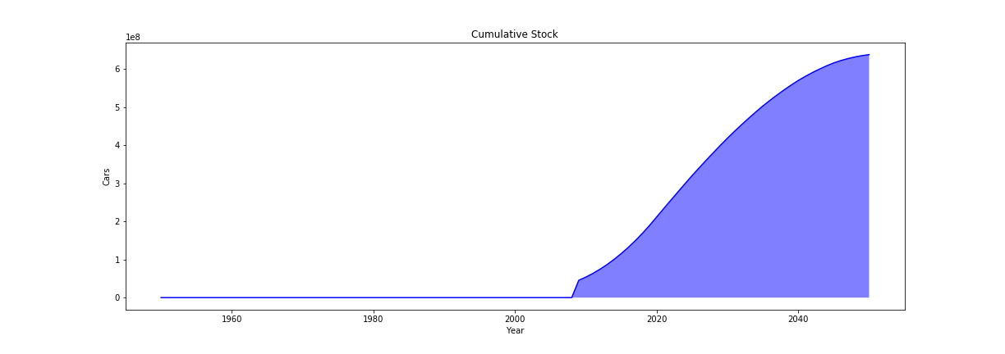
Model builds entire stock of 2008 in one single year: Flows and cohorts will be wrong

Slide 5
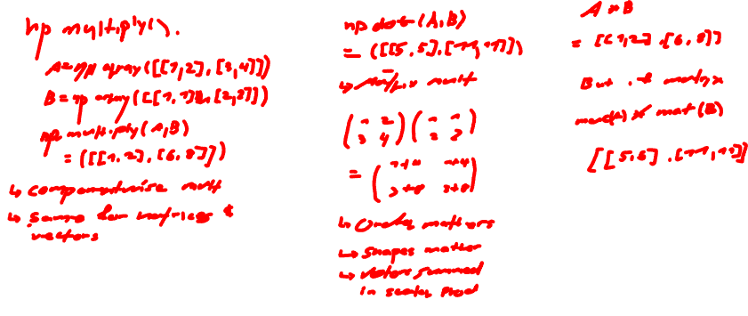
Difference between np.multiply(), np.dot(), and *

Slide 6
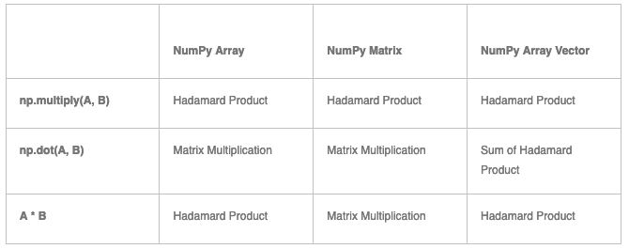
Difference between np.multiply(), np.dot(), and *

Slide 7
Why use np.einsum()
Suppose we have 2 arrays and we want to
Multiply in a particular way
Sum along an axis
Transpose in particular order

Slide 8
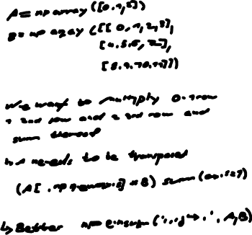
np.einsum()

Slide 9

np.einsum()
Repeating letters in input means that values along those axes will be multiplied together
Used I twice: each col of A multiplied with each row of B
Omitting letter from output means that values will be summed along that axis
Unsumed axes can be turned into any desired order

